Slide 1


CAP-5610 Machine Learning
Spring 2021
Check Point 1 Presentation
Group Number 23
Group Members
Daoyang Song
Fatima Nasir
Marcus Figaro
Nidhi Devi

Slide 2
Breast cancer diagnosis based on feature extraction using hybrid of K-means and
support vector machine algorithms
Authors: Bichen Zheng, Won Yoon , Sarah S. Lam
Publication: Expert Systems with Applications: An International Journal , March 2014

Slide 3
INTRODUCTION
●In United States, Cancer is a major health problem.
●Approx. 1,639,910 new cases of cancer were seen in 2012 and the death count was approx. 577,190.
●Among all these new numbers - breast cancer was the most common cancer diagnosed in women, and accounted for 29% of new female cancer cases - around 790,740 cases.
●With new technologies the data collection and data analysis became quick whereas with huge breast cancer cases it was hard for physicians to collect and analyze detailed cancer feature.
●To filter the pertinent feature information which supports the clinical disease diagnosis was a time taking and complex task, extraction of tumor features is helpful to diagnose breast cancer which is the main objective of this paper.
●To make the feature extraction and selection method less complex and quick machine learning methods are applied

Slide 4
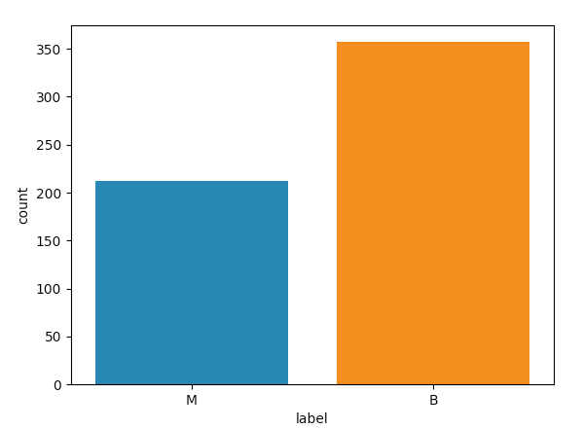
DATA
Source: Wisconsin Diagnostic Breast Cancer (WDBC) from the University of California.
Description: The data contain measurements on cells in suspicious lumps in a woman's breast. Features are computed from a digitized image of a fine needle aspirate (FNA) of a breast mass. They describe characteristics of the cell nuclei present in the image. All samples are classified as either benign or malignant.
Number of Instances :569
Number of Attributes: 32
Number of Missing Values: 0
Attribute Type: Numerical Continuous Real Values
Class distribution: 357 benign, 212 malignant

Slide 5
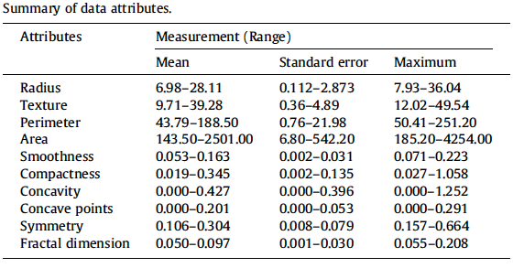
Features
Attribute | Description
Id | Unique id Number
Classification Label | (M = malignant, B = benign)
Radius | mean of distances from center to points on the perimeter
Texture | standard deviation of gray-scale values
Perimeter | Perimeter of cell nuclei
Area | Area of cell nuclei
Smoothness | Local variation in radius lengths
Compactness | (perimeter^2 / area - 1.0)
Concavity | Severity of concave portions of the contour
Concave points | Number of concave portions of the contour
Symmetry | Orientation of cell mass
Fractal dimension | "coastline approximation" - 1
The mean, standard error and "worst" or largest (mean of the three largest values) of these features were computed for each image,
resulting in 30 features.
For instance, field 3 is Mean Radius, field 13 is Radius SE, field 23 is Worst Radius.
Those different measurements are treated as different features in the data set.

Slide 6
Problem Formulation
Clustering+Classification
The proposed method hybridizes K-means algorithm and SVM (K-SVM) for breast cancer diagnosis.
This hybrid of K-means algorithm and SVM is used to condense the existing
feature space to reduce the computational cost for SVM training and maintain a similar diagnosis accuracy.
Following three steps are involved in this method:
Step1: Pattern Recognition - K-means
Step2: Feature Extraction - Fuzzy Membership Function
Step3: Classification - SVM

Slide 7
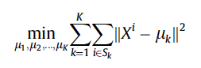
Step1: Pattern Recognition - K-means
K-means is an unsupervised learning algorithm and is good for recognizing hidden patterns in a data.
Kmeans is an optimization problem to minimize the overall distance between cluster centroids and cluster members as follows :
To reduce the high dimensionality of feature space Kmeans is applied individually to extract abstract malignant and benign tumor patterns.
Each cluster represents a specific tumor pattern whereas each cluster center is considered as a new symbolic tumor of that cluster.
In total six clusters , three for each malignant and benign tumors , where each cluster represents a distinctive tumor pattern.
Select clusters based on validity ratio calculation discussed later

Slide 8
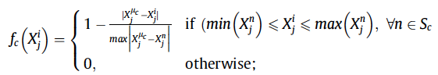
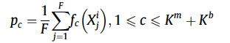
Step2: Feature Extraction - Fuzzy Membership Function

Slide 9
Contd.
The value of the new features represents the similarity between the tumor and the pattern.
These new features are condensed information combining different previous features representing a profile tumor pattern.
The number of features are reduced from 30 to 6 ( using K=3).
The feature selection algorithm not only reduced the dimension of features but also eliminated the noisy information for prediction.
Using simple data mining technique reduced the dimensions and computation time without exhaustive training on different feature subsets.

Slide 10
Step3: Classification - SVM
A generalized SVM is used for searching a hyperplane that separates benign and malignant tumors with maximum margin.
SVM is trained on reduced feature space of 6 distinctive features obtained.
A sigmoid kernel is used for SVM.
10 cross-fold validation is used for training.

Slide 11
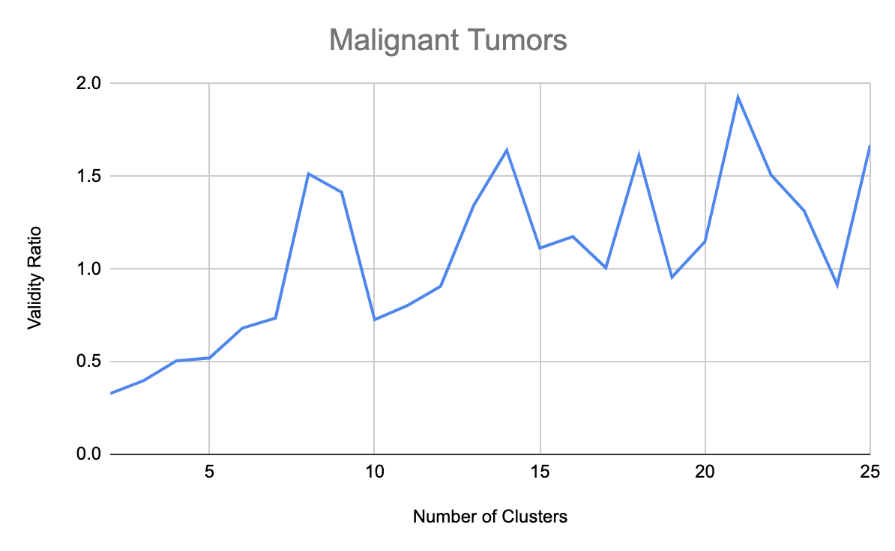
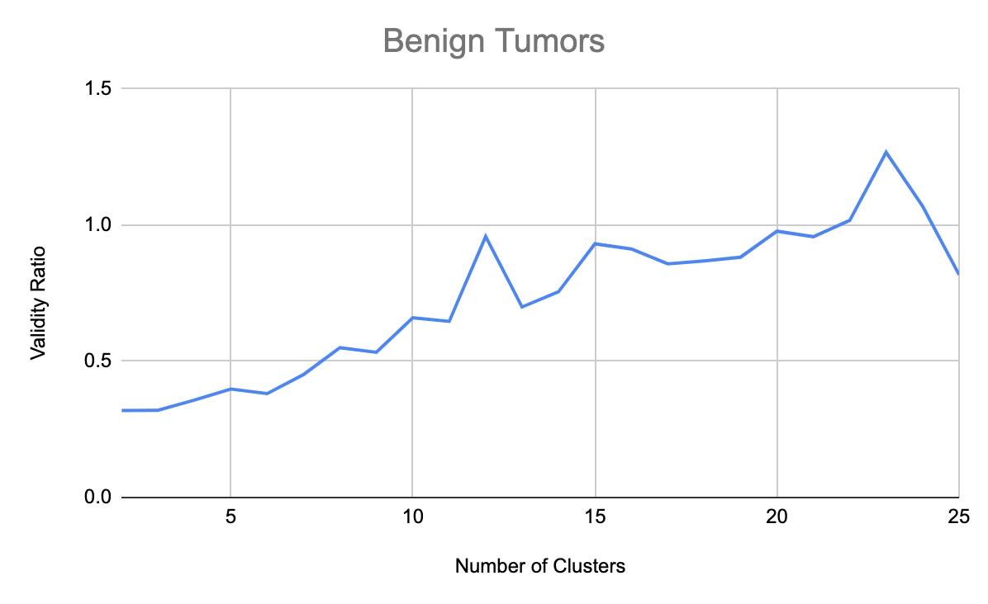
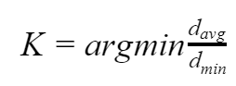
Results
The validity ratio was calculated to find the ideal number of clusters based on the distances between clusters and between the clusters and data points.
Two clusters for each tumor type had the lowest validity ratio, however we believe this is an inconsistency in the code.
We still used three clusters for each tumor type because they had a comparable validity ratio, and produced the same feature space as is described in the paper
We plan on addressing this inconsistency in future project checkpoints
Equation:

Slide 12
Conclusion
The highest Accuracy of Polynomial Function is 0.935.
The highest Accuracy of Sigmoid function is 0.825
The highest Accuracy of RBF is 0.916
The highest Accuracy of Linear is 0.912

